Slide 1

cert-manager
September 1st, 2021

Slide 2
History
Born out of the kube-lego project
Certificate management in Kubernetes lacking
A way to represent CAs and PKI as Kubernetes resources.

Slide 3
What is cert-manager?
Automated certificate management in cloud native environments
Certificate management for Kubernetes
Provide 'certificate as a service' securely to developers and applications working within your cluster
Notes:
Description: this is really an application-oriented proxy, you would not use this to filter user egress traffic
Other products: Contour ingress proxy uses it as a reverse proxy, Istio uses it as it’s default dataplane for providing a full Service Mesh product.

Slide 4
Why use cert-manager
Simplifies the process of obtaining, renewing and using certificates
It can issue certificates from a variety of supported sources: Let’s Encrypt, HashiCorp Vault, Venafi and private PKI.
Can also create and manage certificates using in-cluster issuers such as CA or SelfSigned.
Notes:
Description: this is really an application-oriented proxy, you would not use this to filter user egress traffic
Other products: Contour ingress proxy uses it as a reverse proxy, Istio uses it as it’s default dataplane for providing a full Service Mesh product.

Slide 5
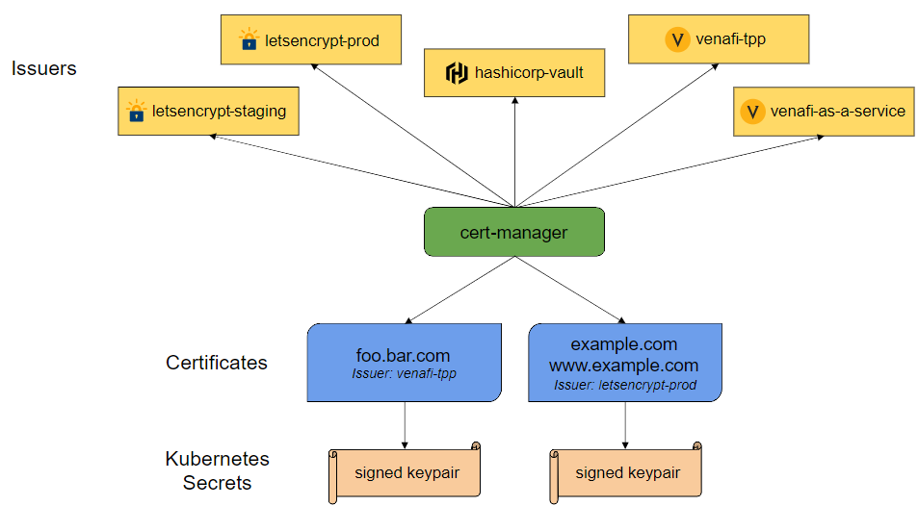
How does it work? Building Blocks…
The Issuers(CA) - to issue certificates
Issuers and Cluster Issuers
Supported Issuer Types: SelfSigned, CA, Vault, Venafi, ACME(Let’s encrypt) and External
The Certificate Resource
Representation of a certificate request
Additional Resources
CertificateRequests
Order
Challenges(ACME)
CA

Slide 6
ACME protocol
ACME Issuer type represents a single account registered with the Automated Certificate Management Environment (ACME) Certificate Authority server
In order for the ACME CA(Let’s encrypt) server to verify that a client owns the domain, or domains, a certificate is being requested for, the client must complete “challenges”
The verification in cert-manager with Let’s Encrypt issuer is either done via a DNS check or an HTTP check.

Slide 7
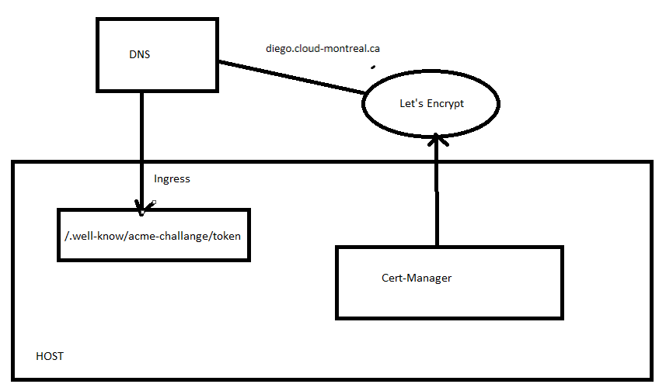
HTTP check
Cert-manager will start the registration of the domain on Let’s Encrypt server. It gets a token from the Let’s Encrypt response
Cert-manager will create a small server to serve a single page with a content based on the token and your Let’s Encrypt account id
Cert-manager will create an “ingress” Kubernetes object on the host
Let’s Encrypt will query the URL and upon successful check on the value, will issue the certificate
Cert-Manager will query Let’s Encrypt server to get the certificate. The certificate is stored in a “secret” Kubernetes object

Slide 8
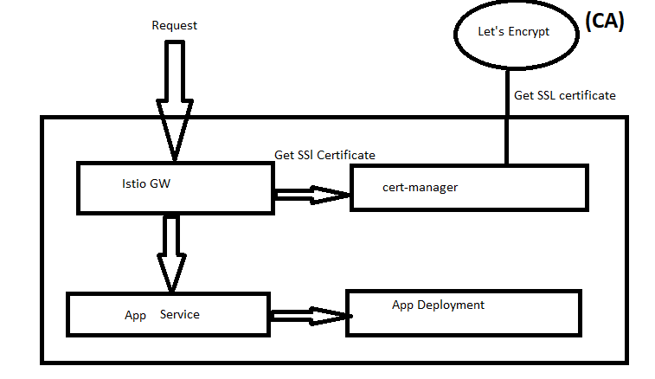

How does it work? Demo…
Get an HTTPs request
Get Certificate for our Istio services. Create an Istio Gateway resource which uses the secret populated by Cert-Manager.
VirtualService will route the traffic to the backend service.
Istio ingress-GW takes SSL certificate and attaches it to the response
Gateway
Virtual Service

Slide 9
Demo
Install Cert-manager with helm and Configure App with dynamic https using ACME using Istio GW or Ingress

Slide 10

Demo
Used the same cluster as the assignments
Installed Istio
Installed cert-manager with helm(Be sure to never embed cert-manager as a sub-chart of other Helm charts)
Create Issuer resource and apply
Create Certificate resource and apply (We have our certificate for our istio services)
Create Gateway resource which uses the secret
Create VirtualService to route traffic to backend Kubenetes service “helloworld”

Slide 11
Thank you!!
Questions?

